Slide 1
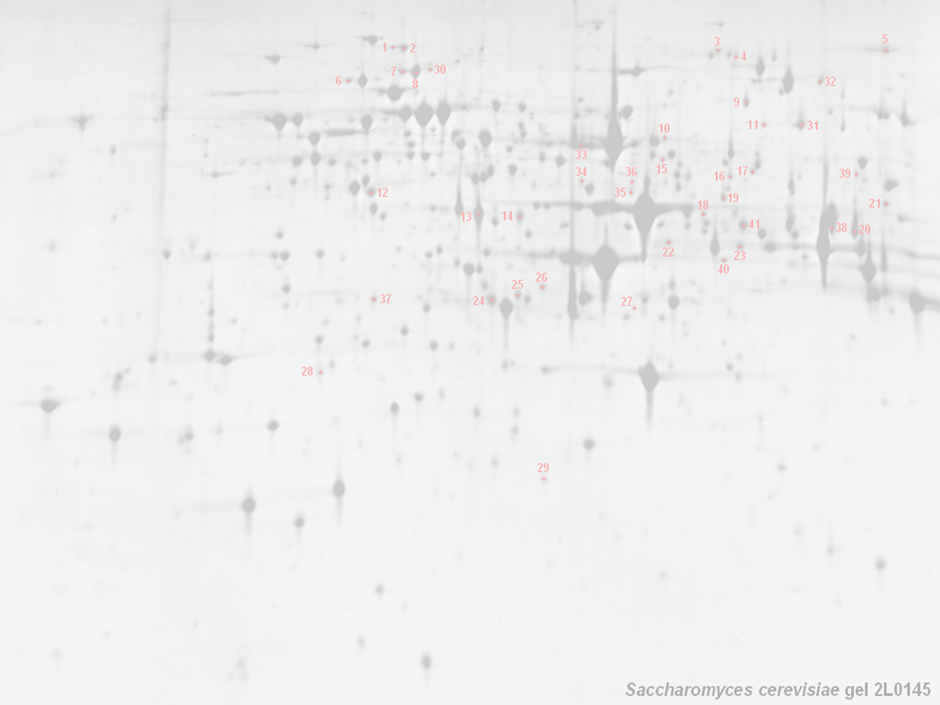



MIAPE: The Minimum Information
About A Proteomics Experiment
HUPO PSI, Chris Taylor, Henning Hermjakob,
Kai Runte, Weimin Zhu, Rolf Apweiler,
European Bioinformatics Institute,
Hinxton, UK (and the rest of the world)

Slide 2
MIAPE — The Background
The volume of generated proteome data is rapidly increasing
  Movement towards high–throughput approaches
  New experimental techniques and analyses (DiGE, ICAT, etc.)
Publicly available proteomics data is rather limited
  Sample extraction and preparation usually undocumented
  Analytical methods employed in deriving conclusions absent
  No widely used databases of (for example) mass spec. data
A robust, future proofed, standard representation of both methods and data from proteomics experiments is required
  Analogous to the MIAME+MAGE system for transcriptomics
  Will facilitate handling, exchange and dissemination of data
    e.g. the development of effective search/analysis tools

Slide 3
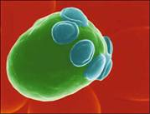
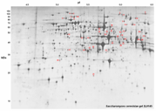

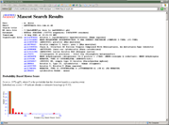
MIAPE — The Scope of the Model
Sample generation
  Origin of sample
    hypothesis, organism, environment, preparation, paper citations
Sample processing
  Gels (1D/2D), columns, other methods
    images, gel type and ranges, band/spot coordinates
    stationary and mobile phases, flow rate, temperature, fraction details
Mass Spectrometry
    machine type, ion source, voltages
In Silico analysis
    peak lists, database name + version, partial sequence, search parameters, search hits, accession numbers

Slide 4
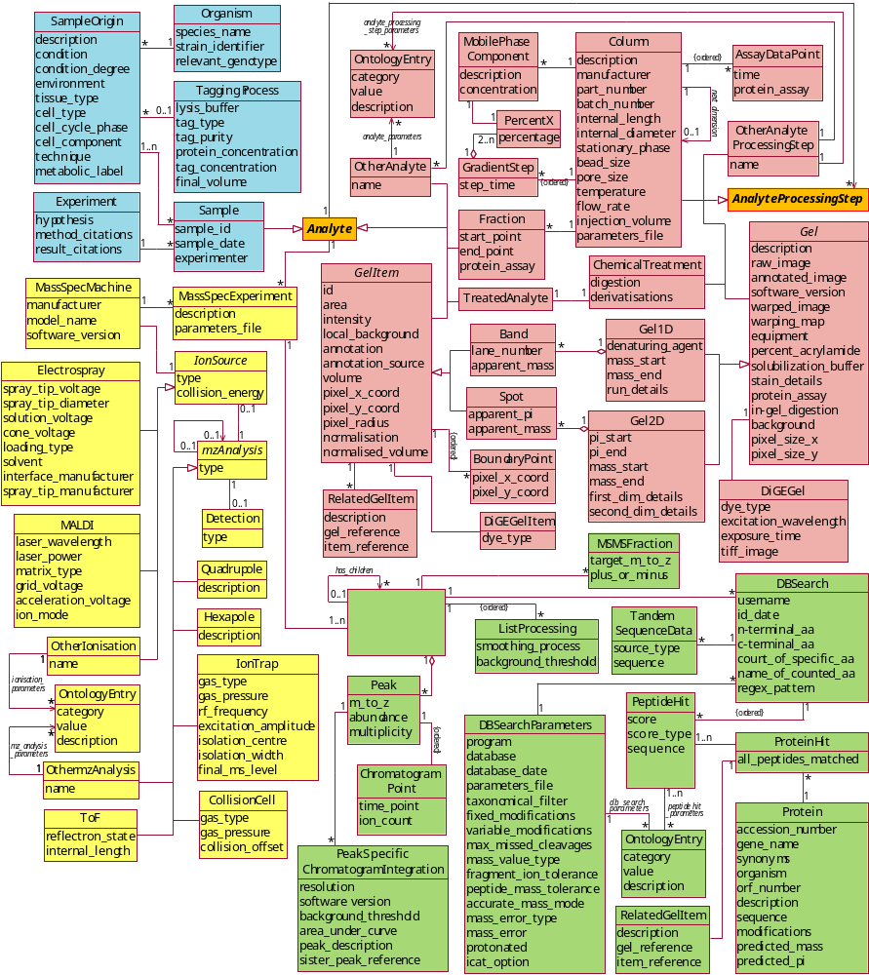

MIAPE — More Background
The PEDRo Model:
Developed at Manchester University in collaboration with the PSI and the EBI
A ‘proof of concept’ model that covers most of the workflows currently found
in proteomics experiments
Intended as a ‘straw man’
to stimulate discussion of the scope and depth that would be required to adequately represent a proteomics experiment

Slide 5
PEDRo → MIAPE
/ PSI-ML / PSI-DB
PEDRo
Manufacturers output formats + mzData model
Input formats for search engines and tools
Consultation with domain experts and MGED
MIAPE
Ontologies?
Public meetings to garner
maximum feedback
Publication in print and via
the web, to reach the widest
possible audience
PSI-ML / PSI-DB

Slide 6
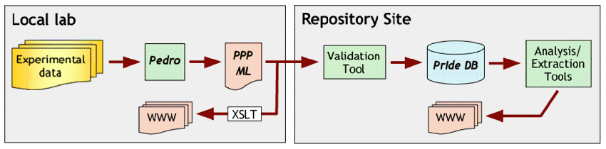
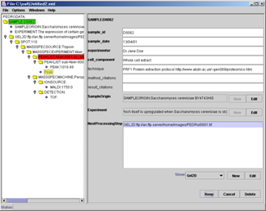
The Pedro Data Entry Tool
A tree-style browser simplifies manipulation of PEML files
Successive steps added as children
thereby enforcing an audit trail
  e.g. gel details cannot be entered
  without describing the sample
Generated from an XML Schema
Straightforward file validation
Use of ‘templates’, copy + paste
Ontology support + context help + security model (in beta)

Slide 7
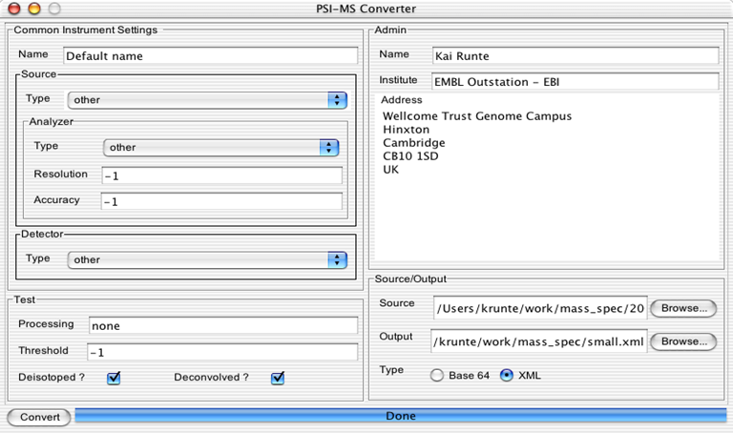
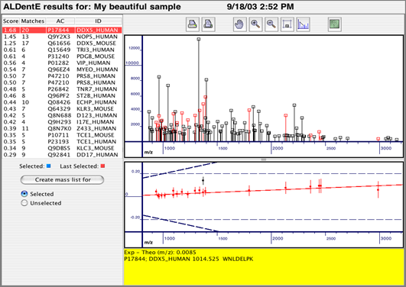
File Conversion and Import
Converter tool development (Kai Runte, EBI)
  Planned input formats (for the immediate future); Bruker-Daltonics, Inc.; Ciphergen; Biosystems, Inc.; Micromass-Waters; Protagen, Inc.; Thermo LabSystems; Institute for Systems Biology
.dta/.zta
pairs
other
formats
Search engine

Slide 8
Provision of repository and tools
Repository solution (Lennart Martens, U. Gent, Belgium, Henning Hermjakob, EBI)
  Initially developed for a database of protein identifications
  Re-useable technology; will be deployed for HUPO tissue projects, and ultimately to capture MIAPE-compliant data sets
PRIDE web
log4j
WWW
XSLT
Struts
PRIDE core
log4j
PRIDE
console
PRIDE DB
persistence
PRIDE XML
persistence
OJB
XPP
$pride:
RDBMS
XML
Log
files

Slide 9
MIAPE — Conclusions
MIAPE will be a modular, expansible model of primary data
  The model is flexible, but should avoid ‘dialectisation’
MIAPE will require a substantial amount of data
  Much of this information will be available in the lab of origin
  Use of templates and copy + paste in Pedro (for example)
But there are several advantages to such a model
  Ability to establish the provenance and relevance of a dataset
  Integration will facilitate sophisticated search and analysis
    Non–standard searches become possible, e.g. by technique
  Tool development and information exchange will be facilitated
The next steps towards MIAPE maturation (by Autumn ‘04)
    Consultation, revision, validation, dissemination

Slide 10
Deliverables and mechanisms
Document #1: ‘MIAPE Principles’
  Our guiding principles for development…
    To make explicit both the scope and purpose of the
    general proteomics model to be developed
Document #2: ‘MIAPE Model’
  The ‘meat’ of the thing…
    Documented UML model and mapping onto XML Schema
    Will make explicit the data and metadata that should be captured from proteomics experiments
    Will provide a reference implementation (PSI-ML, PSI-DB?)
    Will evolve over time, with different versions of the model being produced to take account of changes to experimental techniques and practice

Slide 11
Deliverables and mechanisms
Web site
    A web site will be maintained contains a record of versions, documents and presentations from meetings
Email list
    Used to make announcements and discuss issues
    Details at http://psidev.sourceforge.net/ (soon)
Telcons
    Average frequency of once every two weeks, to discuss issues and activities relating to the development of the standard
    Details posted on the email list
Meetings
  Formal meetings
    Will be associated with full HUPO gatherings
    Will have the authority to approve documents
  Informal meetings
    Will take place between formal meetings, with a view to progressing the documents. Details of future meetings, agendas and minutes will be posted on the email list.

Slide 12
The Art of Modelling
Several models of experimental analyses exist
  Variance in their ‘proteomics’ (even biology) focus
  Each reflects the priorities of the originating community
  Very few have any associated ontological development
Differences in modelling philosophy
  Viewed as a model of an archive or a currency?
  Explicit (proscriptive, simple×2, fragile) versus generic
  (permissive, detailed[…], prone to dialectisation) modelling?
  Can we have a sensible mix of the two (‘adaptive’)?
  Linear or ‘cyclical’ workflows?
Differences in both the breadth and depth of coverage
  GAML, HUP-ML, PEML, ProteinLynx-ML, mzXML, SpectroML, ++

Slide 13
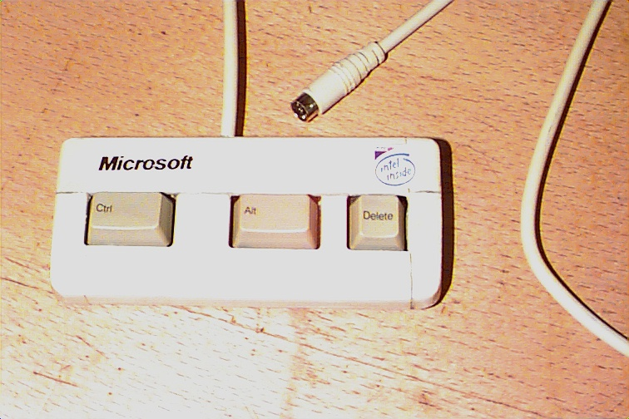


Ontologies, ontologies, ontologies…
1. Inaccessible
2. Multifarious
3. “Just right”
Pre-existing word sources that could be subsumed:
    LSOO, MGED, GO (for example), IBM, MIT, etc.

Slide 14
The Future..?
Functional genomics is the “One ′omics to rule them all”
    but don’t forget the little person…
Several strands of opinion seem to favour a recasting
  Core biological description (sample origination++)
  Add-on modules — transcriptomics, proteomics, metabolomics
How to learn from the bad, while keeping the good?
  Major benefits to a flexible model closely allied to ontologies
  Different benefits to a tightly defined model
  Both have their downsides…
Possible solution — Get your retaliation in first ☺
  Generic model, as above, linked to ‘official’ ontologies
  Domain (and even community) specific ‘Implementation’ models
    derived from the generic model plus ontology terms (data)
    officially guaranteed to map back (future-proof)

Slide 15
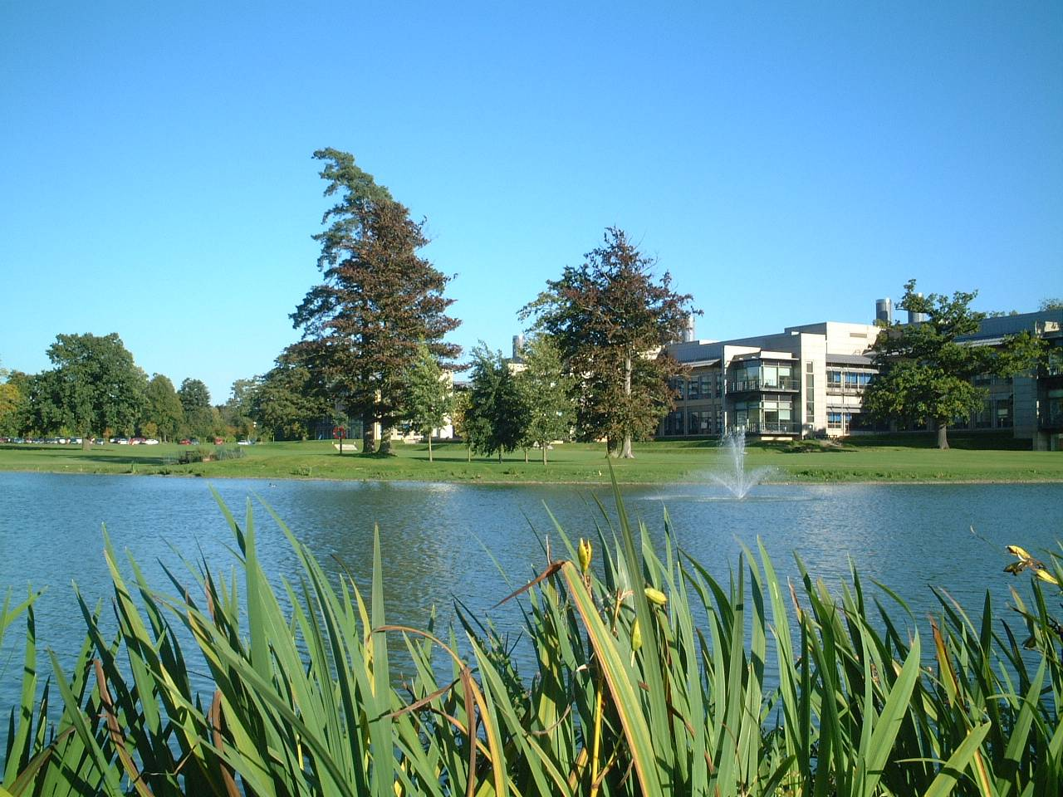


Acknowledgements (lots of them!)
Many people have contributed their advice and expertise to MIAPE, at various meetings formal and otherwise, notably attendees at the 2002 HUPO Proteomics Standards Initiative meetings. Other notable contributions came from:
Weimin Zhu, Kai Runte, Henning Hermjakob, Rolf Apweiler (EBI, UK)
Andy Brass, Steve Oliver, Norman Paton (Manchester, UK)
Randall Julian (ASTM/ASMS)
Simon Hubbard and group, Simon Gaskell and group (UMIST, UK)
Kathryn Lilley and group (Cambridge, UK)
Ruedi Aebersold and group, esp. Eric Deutsch (ISB Seattle, USA)
Al Brown and group (Aberdeen, UK)
Pedro is the continuing project of Kevin Garwood (Manchester, UK)

